Slide 1
Lecture 12 Introduction to Spark
ITP4869 Analysis with Programming Tools
(AY 2018/19)
Dr. Johnny Cheng

Slide 2

Lessons Intended Learning Outcomes
On completion of this lesson, students are expected to be able to:
Describe what Apache Spark is;
List the features of Apache Spark;
Describe the Apache Spark ecosystem;
Install Apache Spark; and
Get started with PySpark.

Slide 3

Introduction to Apache Spark
What is Apache Spark?
Features of Apache Spark
Apache Spark Ecosystem
Spark Deployment

Slide 4
What is Apache Spark?
Apache Spark is a lightweight cluster computing platform.
It is designed for fast computation.
It extends Hadoop MapReduce model to efficiently support more types of computations, which includes batch applications, iterative algorithms, interactive queries and stream processing.
Spark is designed to be highly accessible, offering simple APIs in Python, Java, Scala, R, and SQL, and rich built-in libraries.

Slide 5
What is Apache Spark? (cont.)
Spark is one of the Hadoop’s sub project developed in 2009 at UC Berkeley.
It was open sourced in 2010.
Apache Spark has become a top level Apache project from February, 2014.

Slide 6
Features of Apache Spark
Speed – Spark helps to run an application in Hadoop cluster, up to 100 times faster in memory, and 10 times faster when running on disk.
This is possible by reducing number of read / write operations to disk.
It stores the intermediate processing data in memory.
Swift Processing

Slide 7
Features of Apache Spark (cont.)
Supports Multiple Languages – Spark provides built-in APIs in Python, Java, Scala, R, and SQL.
Therefore, you can write applications in different languages.
Spark comes up with 80 high-level operators for interactive querying.
Advanced Analytics – Spark not only supports ‘map’ and ‘reduce’.
It also supports SQL queries, streaming data, machine learning and graph algorithms.

Slide 8
Features of Apache Spark (cont.)
Dynamic in Nature – We can easily develop a parallel application, as Spark provides 80 high-level operators.
In-Memory Computation – With in-memory processing, we can increase the processing speed.
Reusability – The Spark code can be reused for batch-processing, join stream against historical data or run ah-hoc queries on stream state.
Fault Tolerance – Spark provides fault tolerance through RDD, designed to handle failure of any worker node in the cluster.

Slide 9
Features of Apache Spark (cont.)
Real-Time Stream Processing – Unlike Hadoop MapReduce, we can handle real-time data with Spark Streaming.
Lazy Evaluation – All the transformations we make in Spark RDD are lazy in nature, that is it does not give the result right away rather a new RDD is formed from the existing one.
Integrated with Hadoop – Spark can run independently and also on Hadoop YARN Cluster Manager.
Cost Efficient – Spark is cost effective solution for big data problem as in Hadoop large amount of storage and the large data center is required during replication.

Slide 10
Apache Spark Ecosystem
There are 6 components in Apache Spark Ecosystem which empower to Apache Spark:
Spark Core,
Spark SQL,
Spark Streaming,
Spark MLlib,
Spark GraphX, and
SparkR.

Slide 11
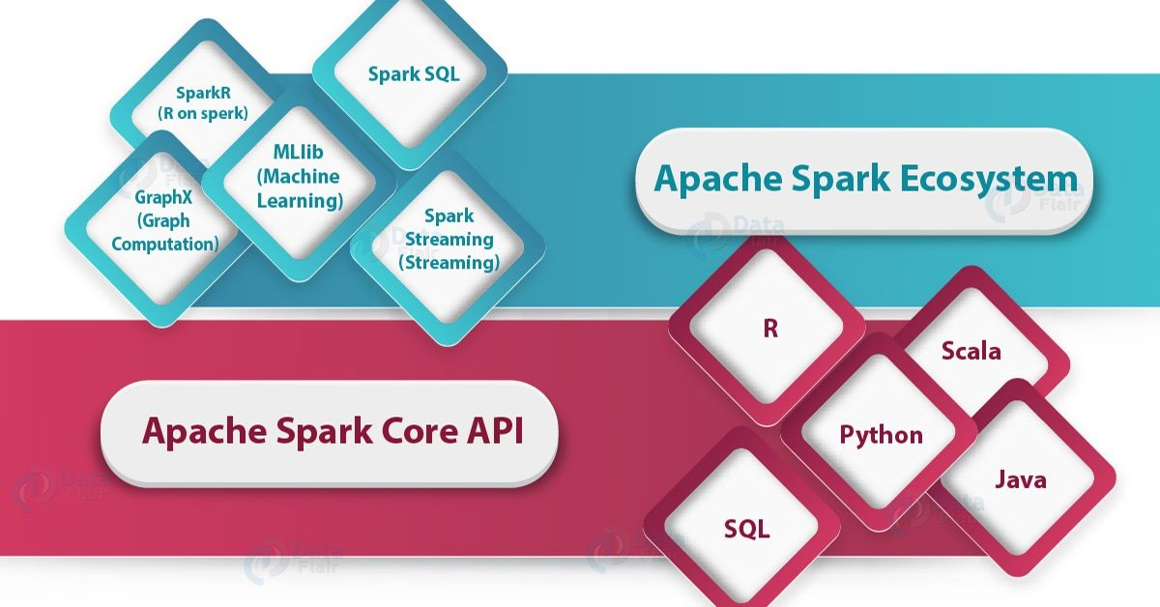
Apache Spark Ecosystem (cont.)

Slide 12
Apache Spark Ecosystem (cont.)
Spark Core
All the functionalities being provided by Apache Spark are built on the top of Spark Core.
It delivers speed by providing in-memory computation capability.
Thus Spark Core is the foundation of parallel and distributed processing of huge datasets.
Spark Core is embedded with a special collection called RDD (resilient distributed dataset).

Slide 13
Apache Spark Ecosystem (cont.)
Spark Core (cont.)
RDD is among the abstraction of Spark.
Spark RDD handles partitioning data across all the nodes in a cluster.
It holds them in the memory pool of the cluster as a single unit.
There are two operations performed on RDDs:
Transformation
Action

Slide 14
Apache Spark Ecosystem (cont.)
Spark Core (cont.)
Transformation – It is a function that produces new RDD from existing RDDs.
Action – In Transformation, RDDs are created from each other. But when we want to work with the actual dataset, then, at that point we use Action.

Slide 15
Apache Spark Ecosystem (cont.)
Spark SQL
Spark SQL component is a distributed framework.
It is a Spark package that allows working with structured and semi-structured data.
Spark SQL allows querying in SQL and HQL (Hive-QL) too which provides declarative query with optimized storage running in parallel.
Apache Hive is a data warehouse system

Slide 16
Apache Spark Ecosystem (cont.)
Spark Streaming
It is an add-on to core Spark API which allows scalable, high-throughput, fault-tolerant stream processing of live data streams.
Spark can access data from a variety of sources.
It can operates using various algorithms.
Spark uses Micro-batching for real-time streaming.
Micro-batching is a techniques that allows a process or task to treat a stream as a sequence of small batches of data.

Slide 17
Apache Spark Ecosystem (cont.)
MLlib (Machine Learning Library)
MLlib is a distributed machine learning framework above Spark because of the distributed memory-based Spark architecture.
GraphX (Graph Computation)
GraphX in Spark is API for graphs and graph parallel execution.
It is network graph analytics engine and data store.

Slide 18
Apache Spark Ecosystem (cont.)
SparkR (R on Spark)
SparkR was Apache Spark 1.4 release.
The key component of SparkR is SparkR DataFrame.
The main idea behind SparkR was to explore different techniques to integrate the usability of R with the scalability of Spark.
It is R package that gives light-weight frontend to use Apache Spark from R.

Slide 19
Spark Deployment
There are three ways of Spark deployment:
Standalone – This means Spark occupies the place on top of HDFS and space is allocated for HDFS, explicitly. Here, Spark and MapReduce will run side by side to cover all Spark jobs on cluster.
Hadoop YARN – This means, simply, Spark runs on YARN without any pre-installation or root access required. It helps integrating Spark into Hadoop ecosystem or Hadoop stack. It allows other components to run on top of stack.

Slide 20
Spark Deployment (cont.)
Spark in MapReduce (SIMR) – This is used to launch Spark job in addition to standalone deployment. With SIMR, user can start Spark and uses its shell without any administrative access.

Slide 21

Installation and Getting Started
Installation of Apache Spark
Getting Started with PySpark

Slide 22
Installation of Apache Spark
Install Java SE
You can download the latest version from
http://www.oracle.com/technetwork/java/javase/downloads/index.html
Install Spark 2.4.3 (7 May 2019)
Download spark-2.4.3-bin-hadoop2.7.tgz (Pre-built for Apache Hadoop 2.7 and later) from
http://spark.apache.org/downloads.html
Unzip the files to a folder “C:\Dev\Spark\spark-2.4.3-bin-hadoop2.7\”.

Slide 23
Installation of Apache Spark (cont.)
Install Hadoop WinUtils
You need some additional binary files to run the pre-built Spark version.
Locate winutils.exe from the following link:
https://github.com/steveloughran/winutils/tree/master/hadoop-2.7.1/bin
Copy file winutils.exe to the folder:
C:\Dev\Spark\spark-2.4.3-bin-hadoop2.7\bin

Slide 24
Installation of Apache Spark (cont.)
Configure your environment
Set the environment variables according to your software version and location.
This is an example:
JAVA_HOME=C:\Dev\Java\jdk1.8.0_211
SPARK_HOME=C:\Dev\Spark\spark-2.4.3-bin-hadoop2.7
HADOOP_HOME=C:\Dev\Spark\spark-2.4.3-bin-hadoop2.7
PYSPARK_DRIVER_PYTHON=jupyter
PYSPARK_DRIVER_PYTHON_OPTS=notebook
Method 1 Only

Slide 25
Installation of Apache Spark (cont.)
Configure your environment (cont.)
Include the following folders to the environment variable ‘Path’:
C:\Dev\Java\jdk1.8.0_211\bin
C:\Dev\Spark\spark-2.4.3-bin-hadoop2.7\bin
C:\Users\a1\Anaconda3\Scripts

Slide 26
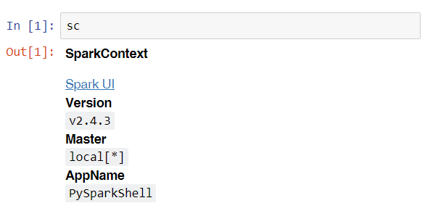
Installation of Apache Spark (cont.)
Verify your installation – Method 1
Execute "pyspark" to start Jupyter and create a new notebook.
Type "sc" in a new cell and then run the cell.

Slide 27
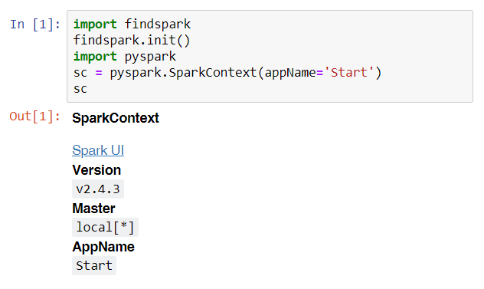
Installation of Apache Spark (cont.)
Verify your installation – Method 2
Start Jupyter and create a new notebook.
Execute the following commands in a new cell.
Before using the module findspark, you have to install it first. At an Anaconda prompt, type:
pip install findspark

Slide 28
Installation of Apache Spark (cont.)
Additional Installation (Optional)
Grant permission to temp folder
Create a temp folder under C:\tmp\hive
Execute below command as administrator:
$ winutils.exe chmod 777 C:\tmp\hive
Install Eclipse and Apache Maven
To develop Spark applications in Java, you may need some Java IDE, say Eclipse, and install Apache Maven, a software project management and comprehension tool.

Slide 29
Installation of Apache Spark (cont.)
Additional Installation (cont.)
Install Scala
https://www.scala-lang.org/download/
Windows: scala-2.13.0.msi
Set SCALA_HOME
Add %SCALA_HOME %\bin to Path
Run Spark shell
$ spark-shell

Slide 30
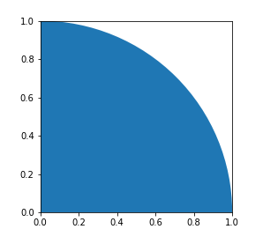
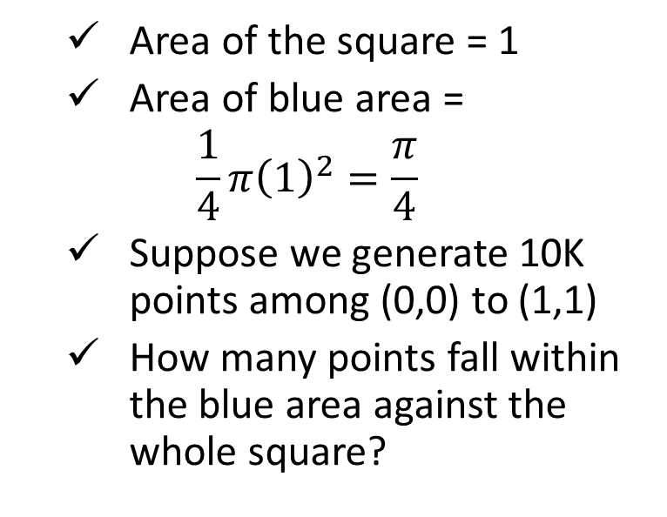
Getting Started with Apache Spark
Get started with PySpark by trying two examples.
Example 1: Pi Estimation
Area of the square = 1
Area of blue area =
$$\frac{1}{4}π{\left(1\right)}^{2}=\frac{π}{4}$$
Suppose we generate 10K points among (0,0) to (1,1)
How many points fall within the blue area against the whole square?

Slide 31
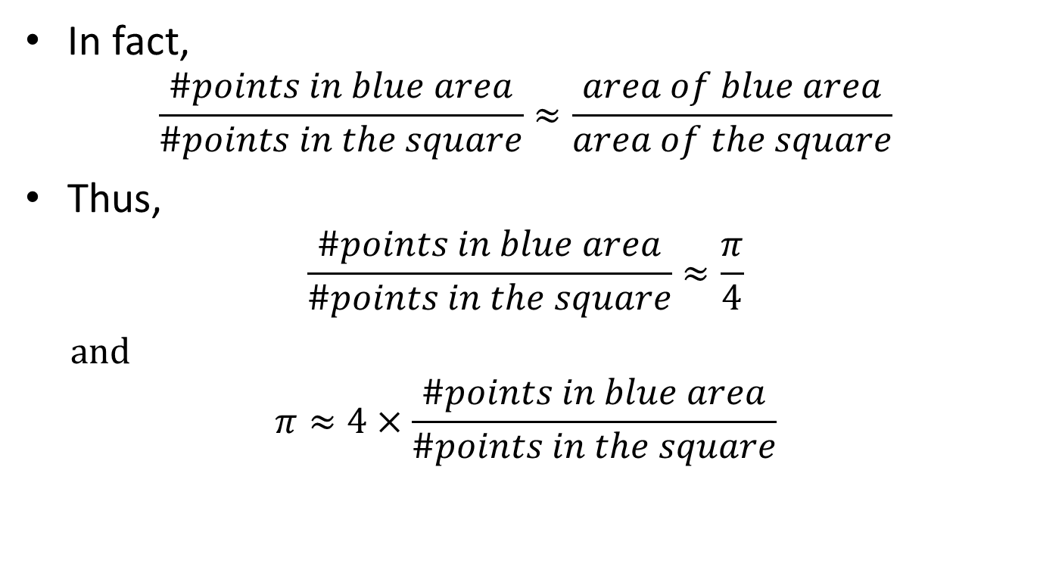
Getting Started with Apache Spark (cont.)
In fact,
$$\frac{\#points in blue area}{\#points in the square}≈\frac{area of blue area}{area of the square}$$
Thus,
$$\frac{\#points in blue area}{\#points in the square}≈\frac{π}{4}$$
and
$$π≈4×\frac{\#points in blue area}{\#points in the square}$$

Slide 32
Getting Started with Apache Spark (cont.)
The PySpark code for Pi Estimation example:
# PySpark Example: Pi Estimation
import random
def inside(p):
x, y = random.random(), random.random()
return x*x + y*y < 1
NUM_SAMPLES = 10000
count = sc.parallelize(range(0, NUM_SAMPLES)) \
.filter(inside).count()
print("Pi is roughly %f" % (4.0 * count / NUM_SAMPLES))

Slide 33
Getting Started with Apache Spark (cont.)
Example 2: Word Count
Read a large text file, sample.txt, with >32K lines.
Split all the lines into words.
Create a tuple for each word: (word, 1)
Reduce all these tuples with the same word and sum up all the ‘1’s.
Store the results in some text files under a specified folder.
From Moodle

Slide 34
Getting Started with Apache Spark (cont.)
The PySpark code for Word Count example:
# PySpark Example: Word Count
text_file = sc.textFile("sample.txt")
counts = text_file.flatMap(lambda line: line.split(" ")) \
.map(lambda word: (word, 1)) \
.reduceByKey(lambda a, b: a + b)
counts.saveAsTextFile("counts")

Slide 35

Self Study Guide

Slide 36
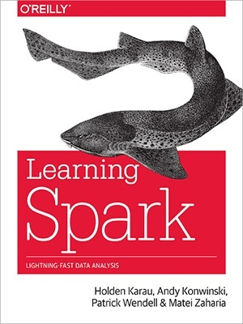
Self Study Guide
Reference
Holden Karau, et al. (2015). Learning Spark, O’Reilly.
(Read Ch. 1 & 2)
Apache Spark – Official Website
https://spark.apache.org/
PySpark API
http://spark.apache.org/docs/2.4.3/api/python/pyspark.html

